Slide 1

How Will Climate Change Reshape City-Level Hazards? A Case Study of London, LA, and Tokyo
Spencer Read

Slide 2
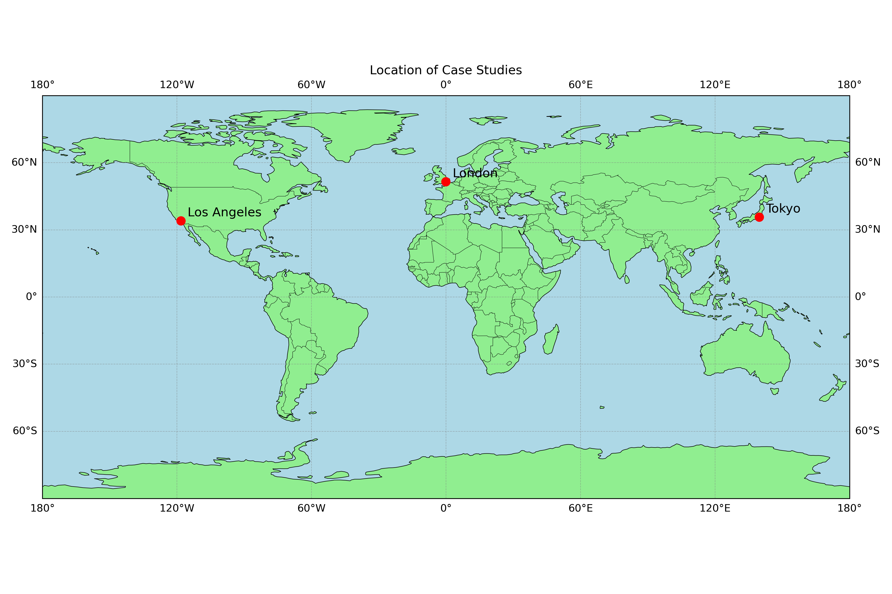
Introduction: Climate Risks and CMIP6
Climate change is accelerating, increasing heatwaves, floods, and extreme events
GCMs help us understand future risks at global and regional scales
CMIP6 provides standardised simulations under multiple socio-economic futures (Carvalho, 2021)
This study explores London, LA, and Tokyo using three GCMs across two SSPs looking at Air Temperature and Precipitation

Slide 3
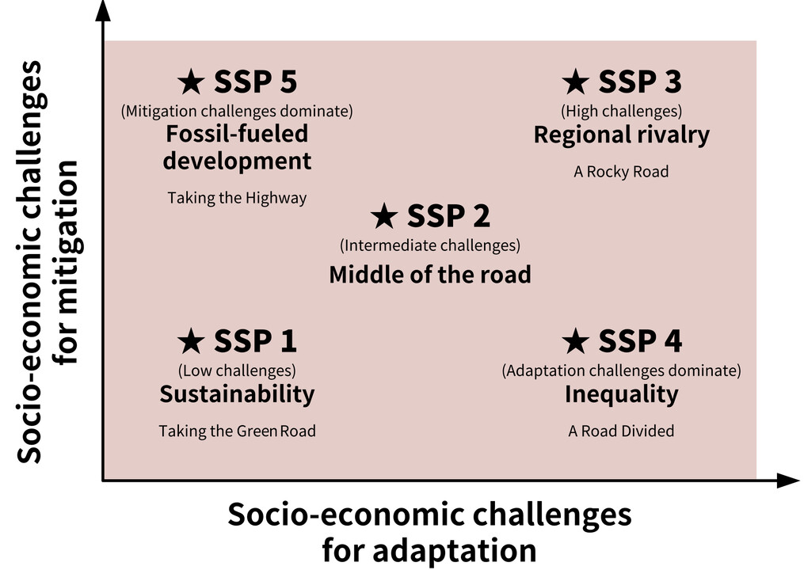
Socioeconomic Scenarios: Context & Selection
SSPs: are future climate scenarios used in CMIP6 to project how the climate might evolve under different societal and economic conditions.
Study will use SSP 2-4.5 and SSP 5-8.5
These were chosen to represent a moderate and a high-emissions future, offering contrasting climate risk pathways

Slide 4
Case Study 1: London, UK
Why London?
Major financial hub; densely populated
High exposure to surface water flooding
Urban heat island effect increases heatwave risks
River Thames: key flood hazard
Model: UKESM1-0-LL
Developed by UK Met Office
Coupled atmosphere-ocean-biosphere system
Used in UKCP18 and IPCC AR6
Research Question: How is flood risk in London projected to change under future climate scenarios?

Slide 5
Case Study 2: Los Angeles, USA
Why LA?
Dense population & economic significance
Exposed to extreme heat, droughts, and wildfires
Strong urban heat island effect
Model: CESM2-WACCM
Developed by NCAR
Captures interactions between lower and upper atmosphere
Suited to heat extremes and detailed atmospheric chemistry interactions
Research Question: How will temperature extremes and droughts evolve in LA under future climate scenarios?

Slide 6
Case Study 3: Tokyo, Japan
Why Tokyo
World’s largest metro area
Exposed to typhoons, flooding, and heat
Coastal city with dense infrastructure
Model: MIROC6
Developed in Japan (U. Tokyo, JAMSTEC, NIES)
Strong on Asian monsoon and tropical rainfall
Effective for studying seasonal extremes
Research Question: Will typhoon-season rainfall intensify in Tokyo under future climate conditions?

Slide 7
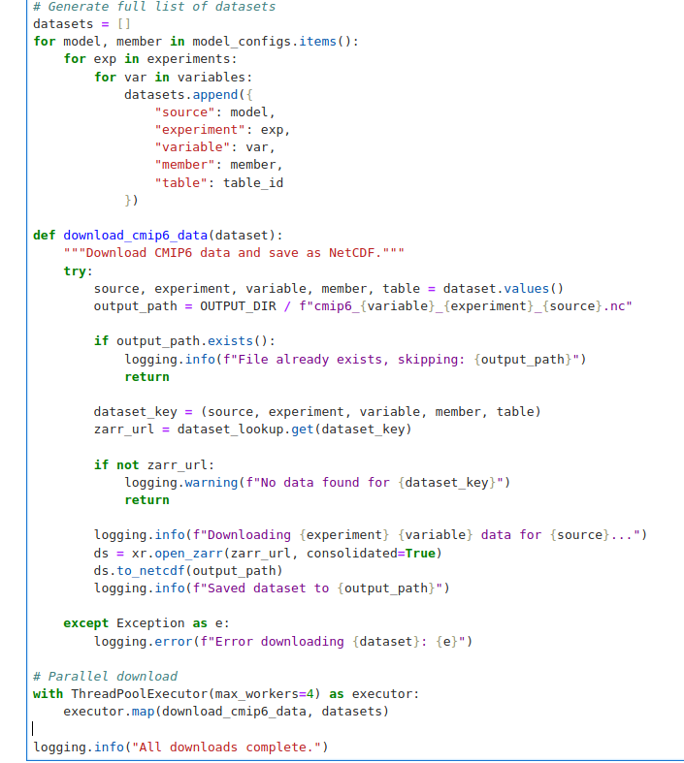
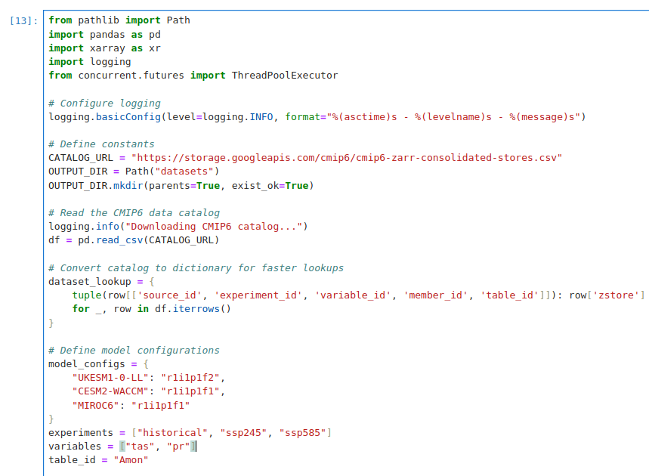
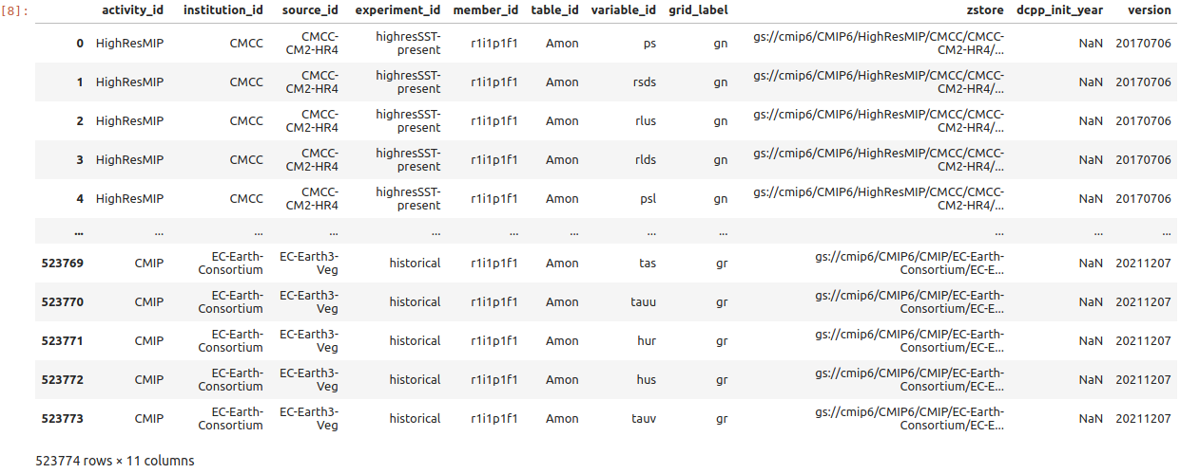
Methodology
Data
Access
Accessed CMIP6 via Google Cloud Public Datasets
Filtered model, SSP, variable via pandas; loaded Zarr with xarray
Exported to NetCDF

Slide 8
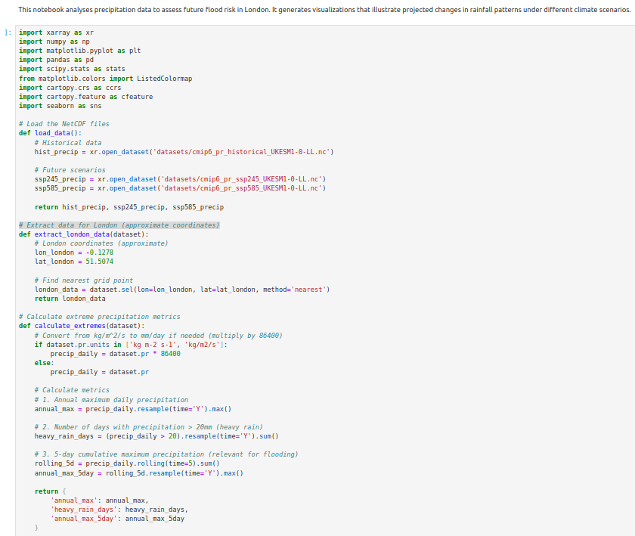
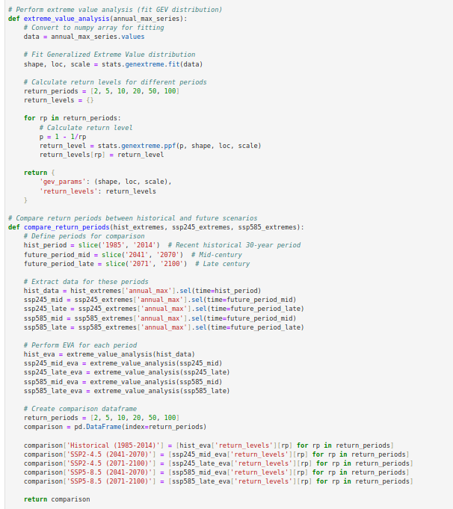
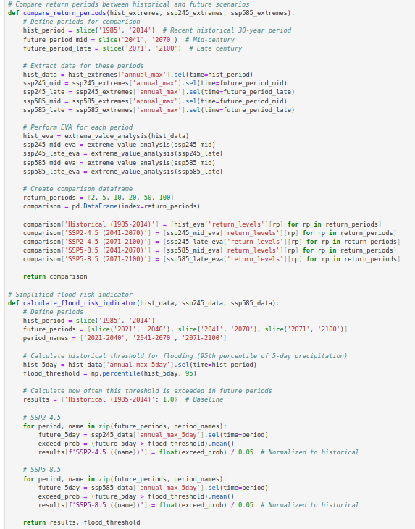
Methodology
Data
Access
Data Analysis
Accessed CMIP6 via Google Cloud Public Datasets
Filtered model, SSP, variable via pandas; loaded Zarr with xarray
Exported to NetCDF
Extracted seasonal and annual means for temperature and precipitation
Computed statistics using packages: scipy and numpy
Compared historical vs. SSP2-4.5 and SSP5-8.5 scenarios

Slide 9
Methodology
Data
Access
Data Analysis
Data Visualisation
Accessed CMIP6 via Google Cloud Public Datasets
Filtered model, SSP, variable via pandas; loaded Zarr with xarray
Exported to NetCDF
Extracted seasonal and annual means for temperature and precipitation
Computed statistics using packages: scipy and numpy
Compared historical vs. SSP2-4.5 and SSP5-8.5 scenarios
Used matplotlib and seaborn for time series and distribution plots
Highlighted key changes and extremes across SSPs
Tailored plots for each case study location

Slide 10
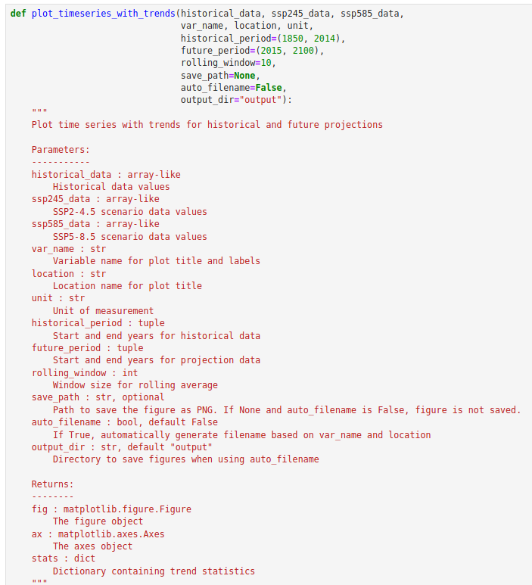
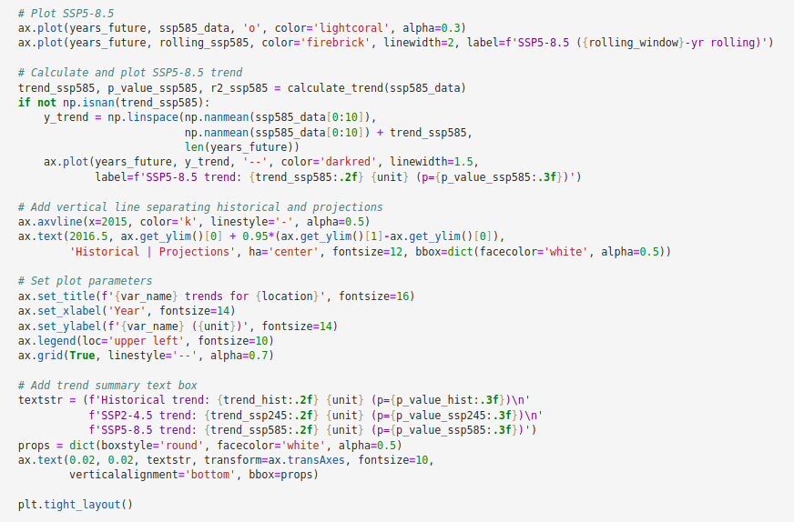
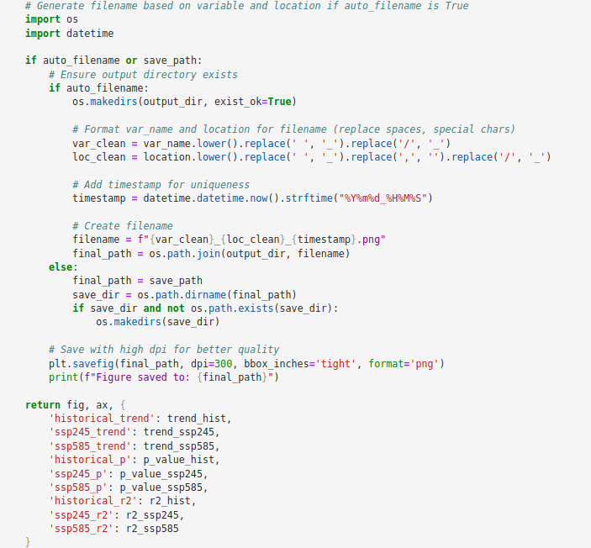
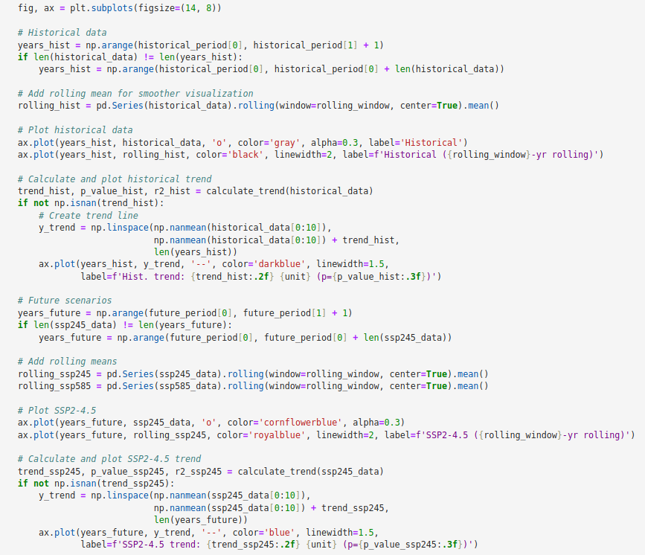

Slide 11

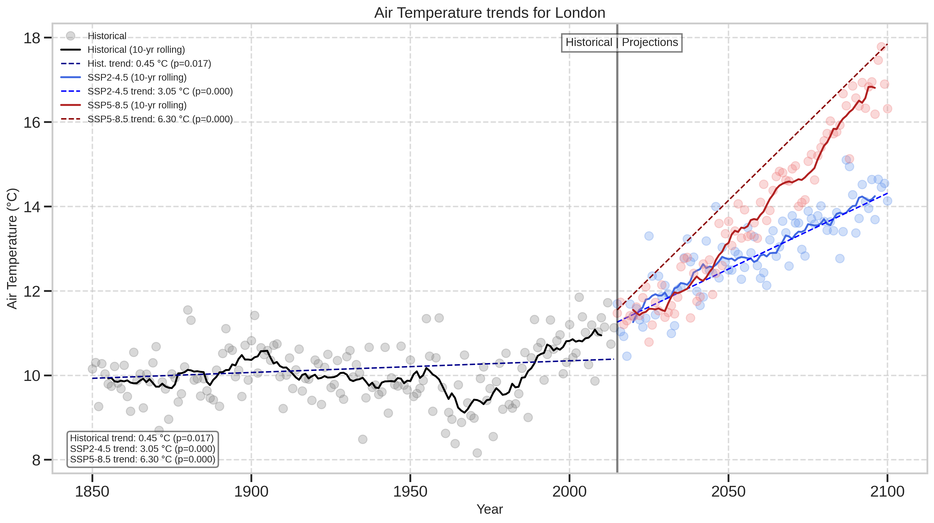
London – Temperature Trends
Temperature shows a consistent upward trend, with accelerated warming after 2000, especially under SSP5-8.5.

Slide 12
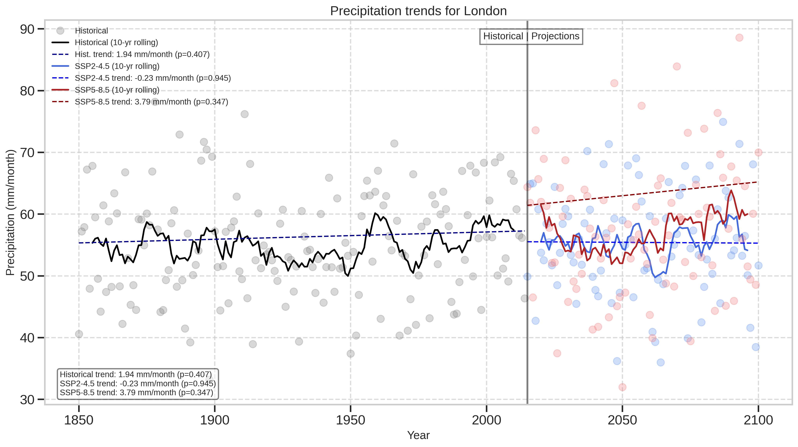
London – Precipitation Trends
Precipitation increases slightly over time, with more pronounced trends under SSP5-8.5, supporting increased flood risk

Slide 13
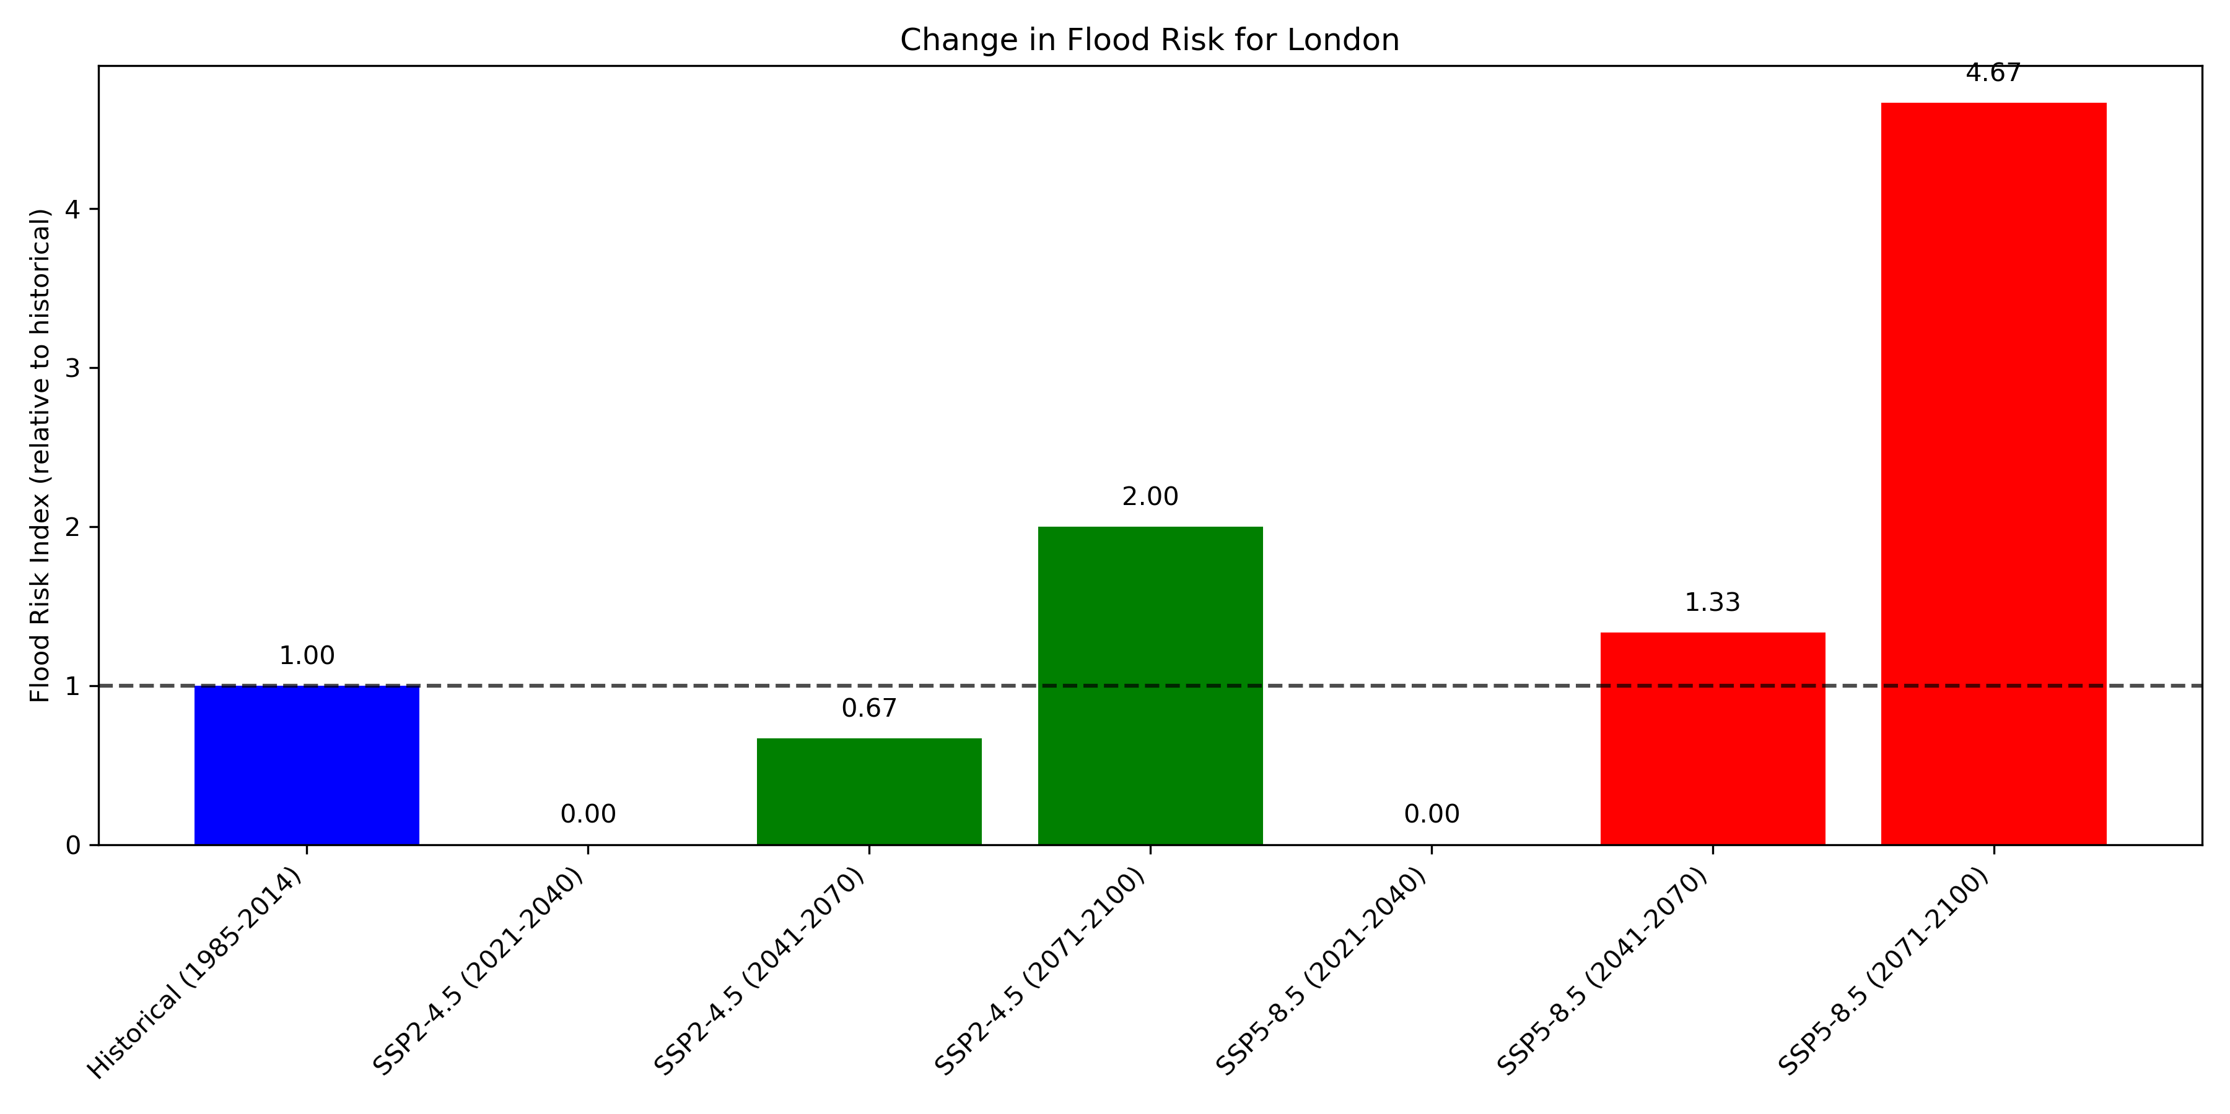
🌧️ London – Flood Risk 🌧️
Flood risk remains stable through 2040
By 2100, risk doubles under SSP2-4.5, and is nearly 5× higher under SSP5-8.5
Highlights need for long-term adaptation, despite short-term stability

Slide 14
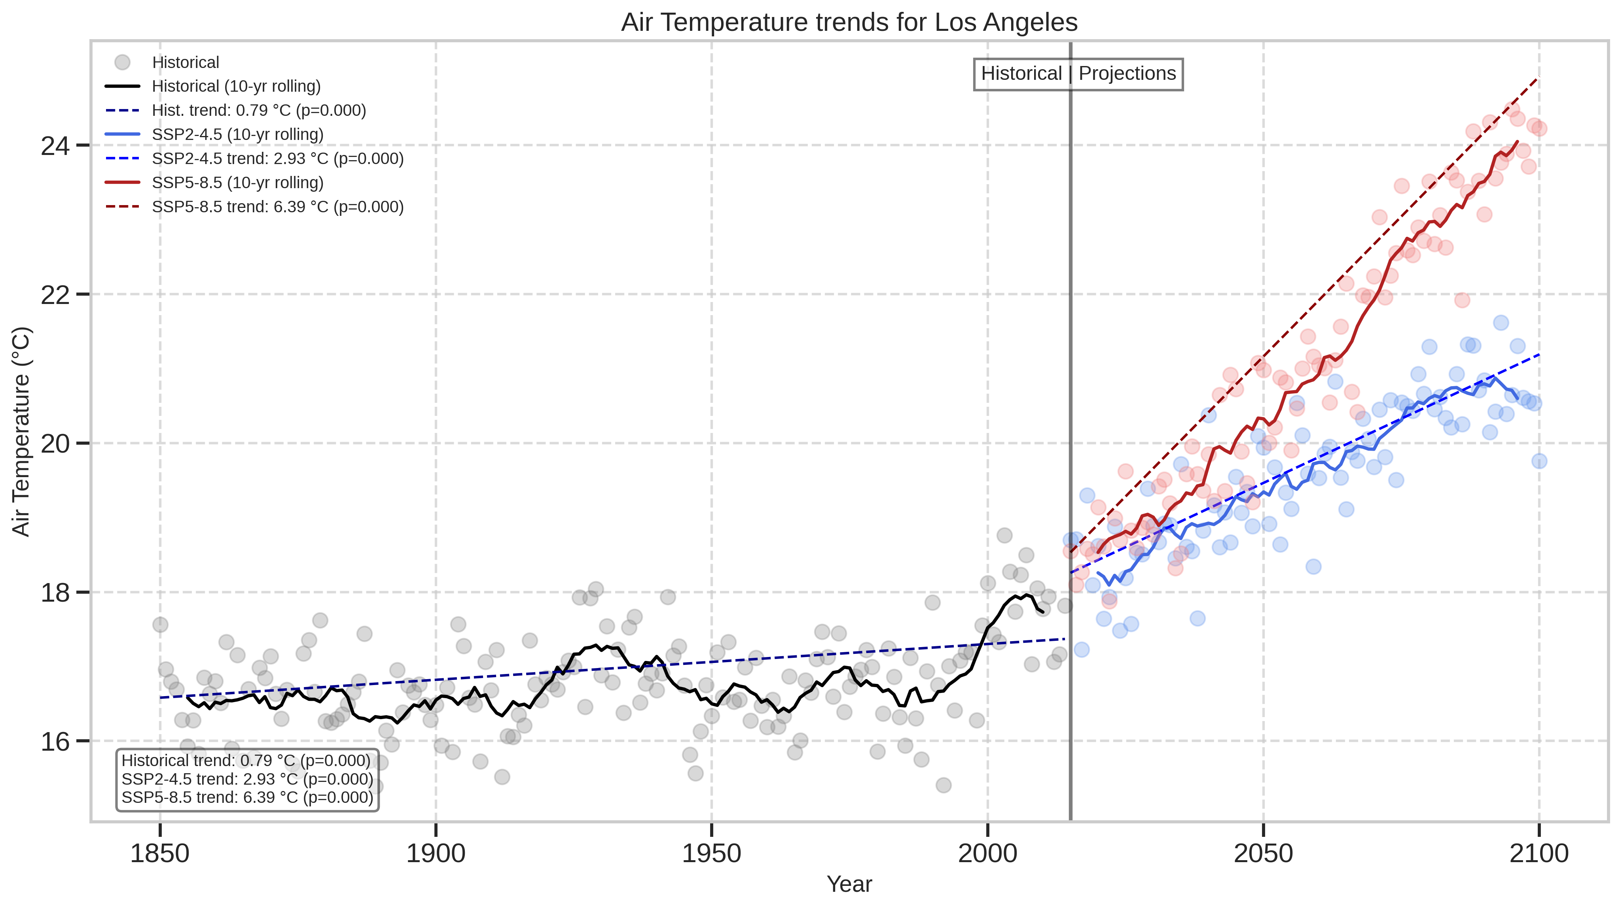
Los Angeles – Temperature Trends
Temperature trends reveal substantial warming, especially under SSP5-8.5, where increases are both sharper and sustained.

Slide 15
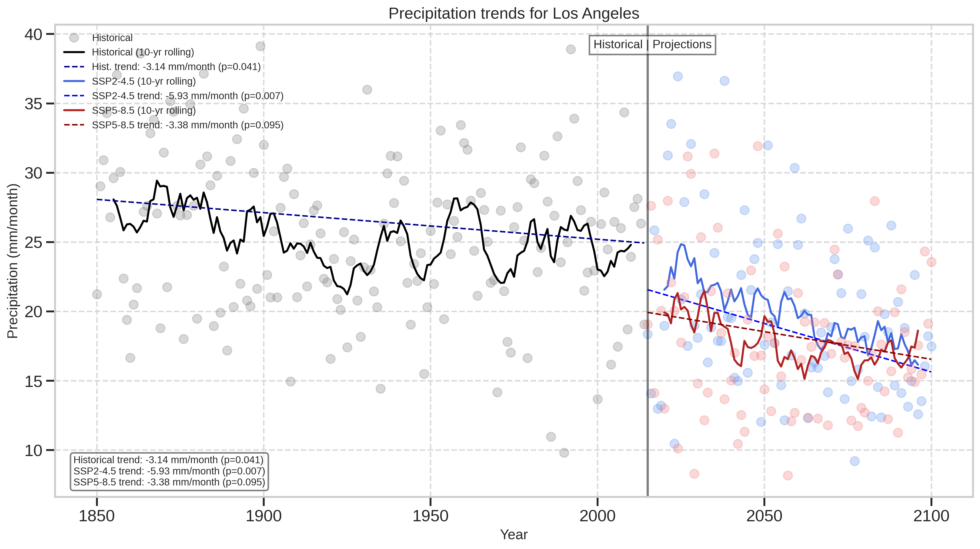
Los Angeles – Precipitation Trends
Precipitation shows a slight downward or variable trend, particularly in SSP2-4.5, with more erratic rainfall under SSP5-8.5.
Suggests increase in drought risk

Slide 16
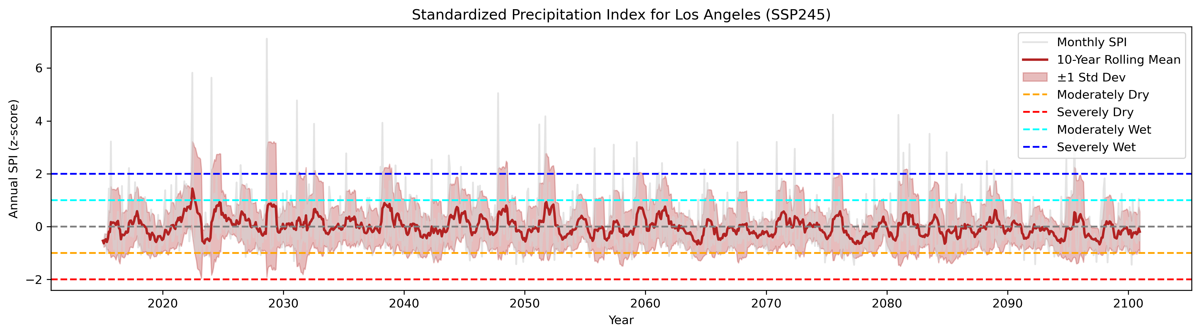
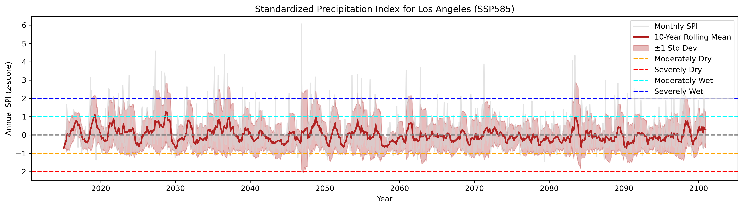
🔥 Los Angeles – Drought & Heat Risk 🔥
No strong trend in either scenario; SPI remains within ‘normal’ conditions.
Slight dip in SPI under SSP585 around 2080–2095 suggests mild drying.
Higher positive (>2) monthly values suggesting increase in extreme precipitation events.

Slide 17
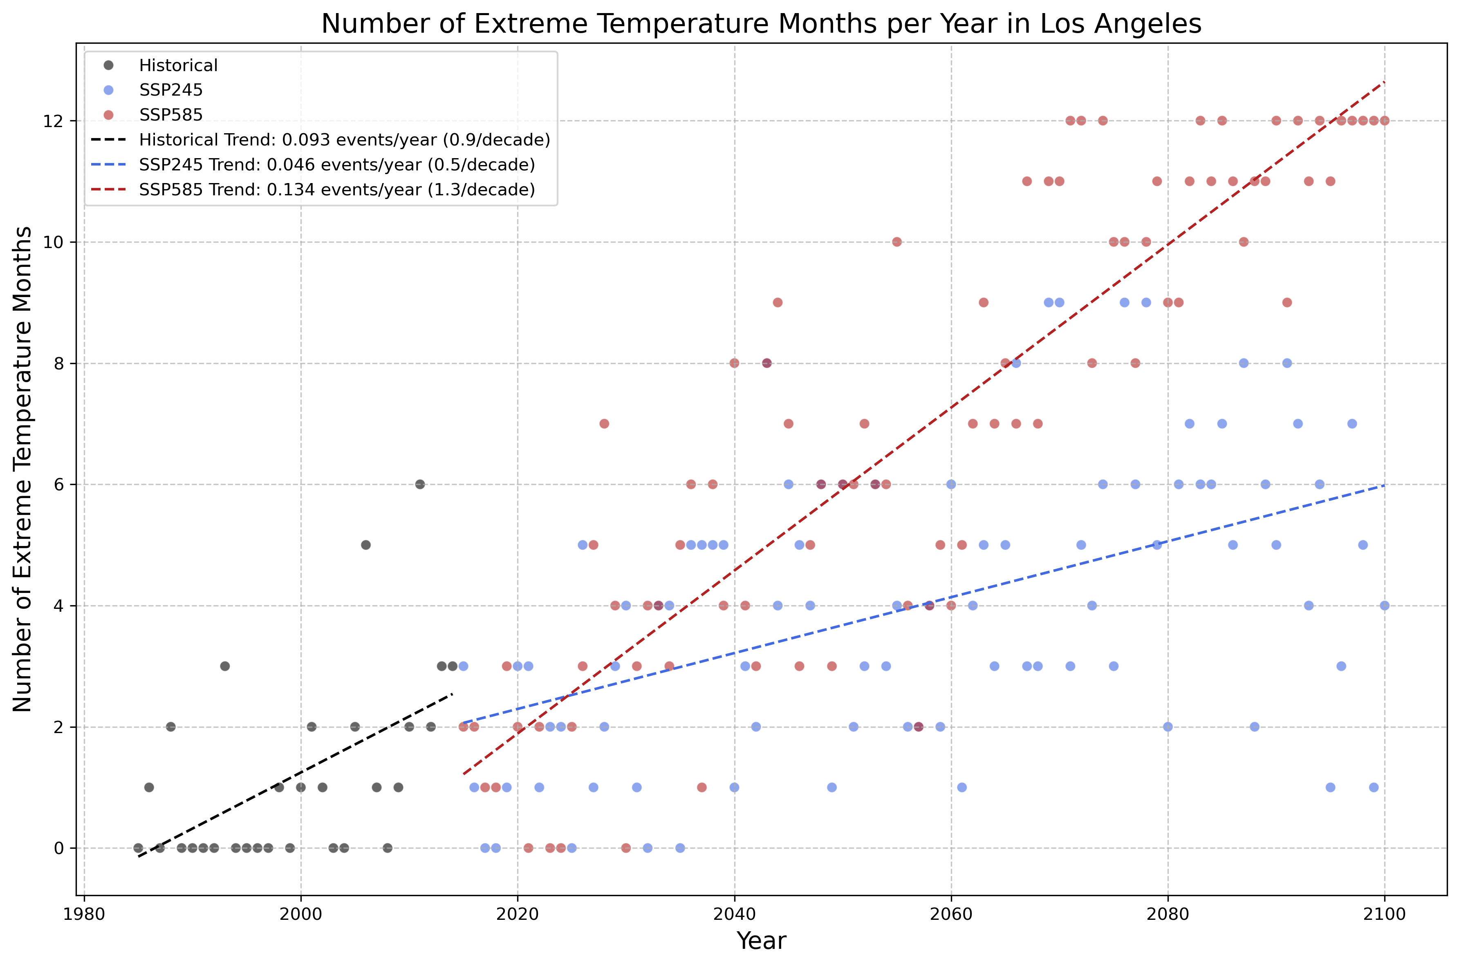
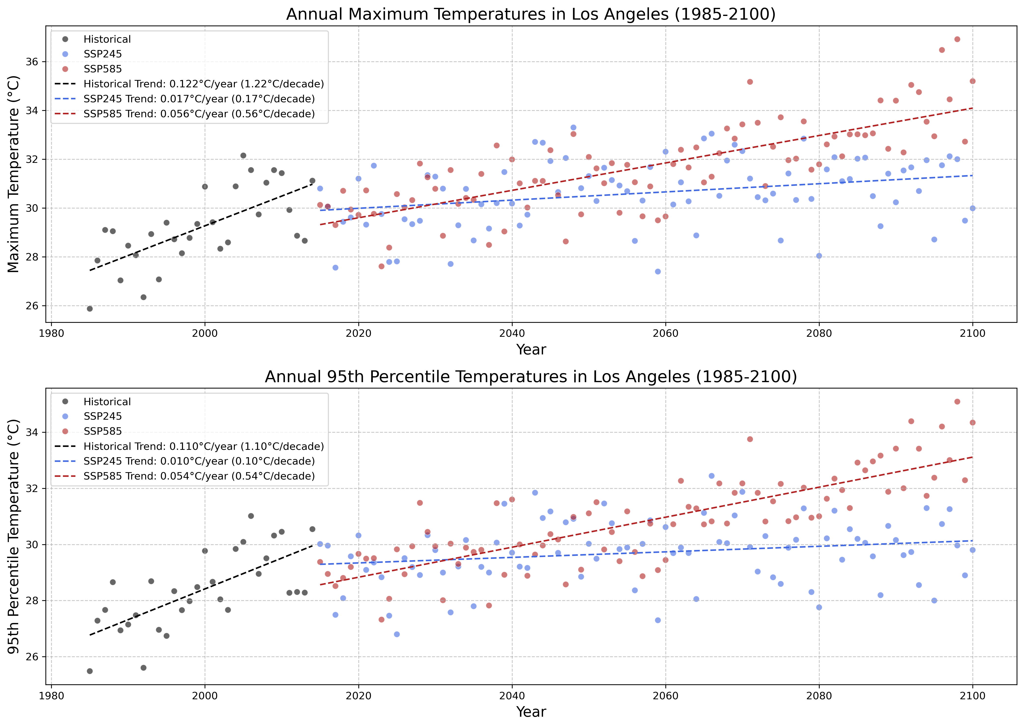
🔥 Los Angeles – Drought & Heat Risk 🔥
Historical warming (1985-2014): ~1.2°C per decade
By 2100, under high emissions (SSP585):
Annual maximum temperatures increase by 4-6°C
Nearly all months (10-12 per year) become "extreme" by historical standards
Moderate emissions scenario (SSP245) shows much less warming (~0.1-0.2°C per decade)

Slide 18
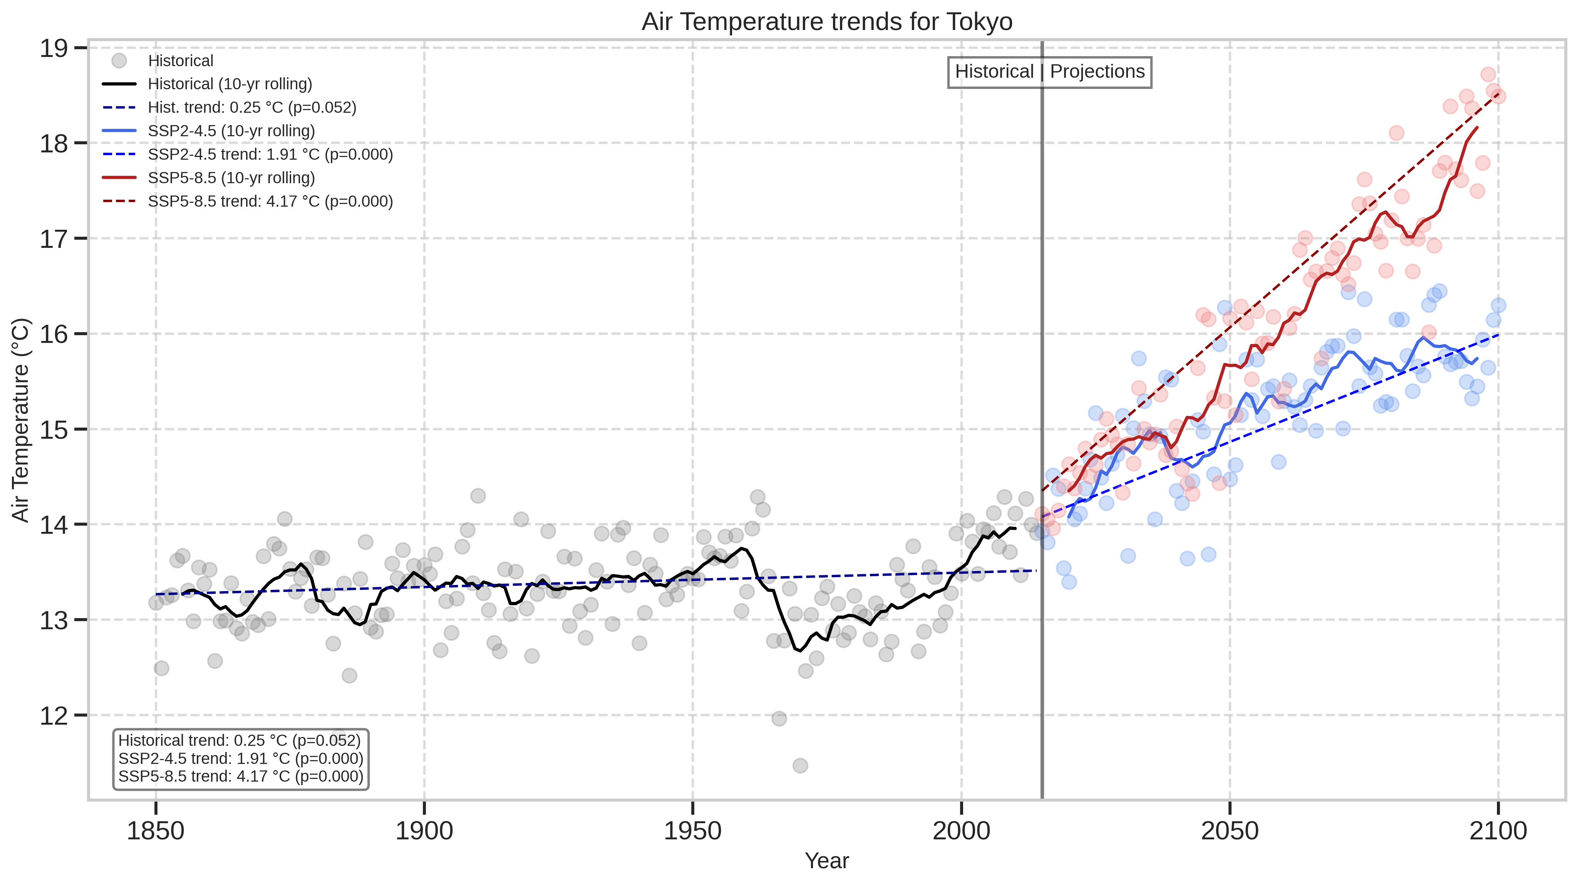
Tokyo – Temperature Trends
Temperature rises under both scenarios, with SSP5-8.5 showing a sharper increase.

Slide 19
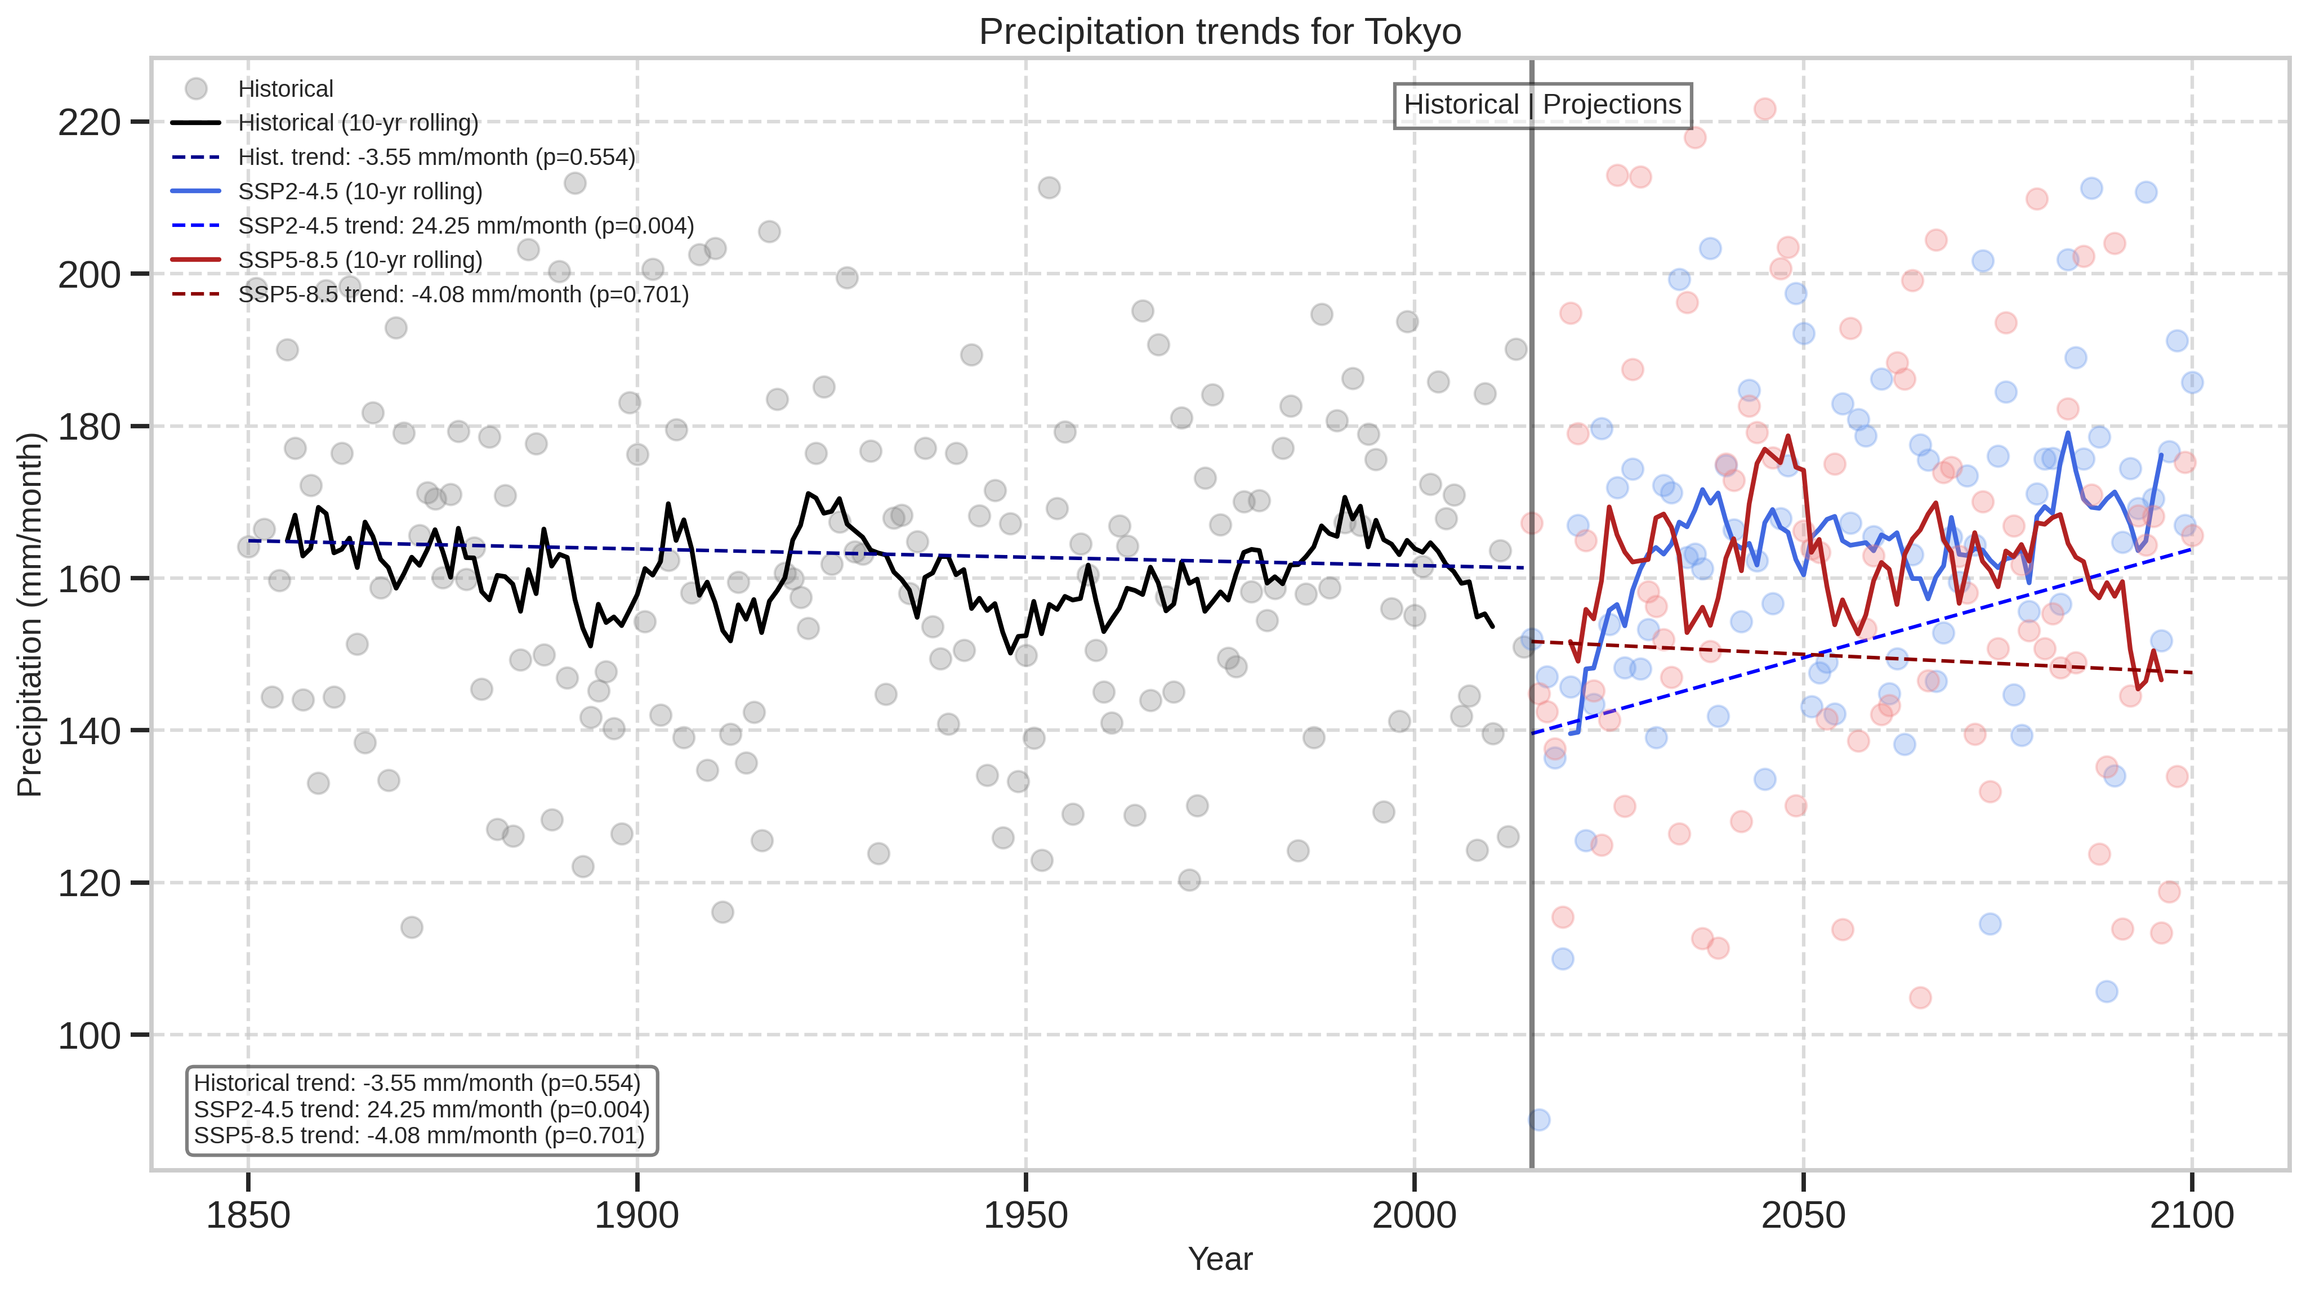
Tokyo – Precipitation Trends
Precipitation exhibits a notable increase, especially under SSP2-4.5, and a slight decrease under SSP5-8.5.
Both show a large variability

Slide 20
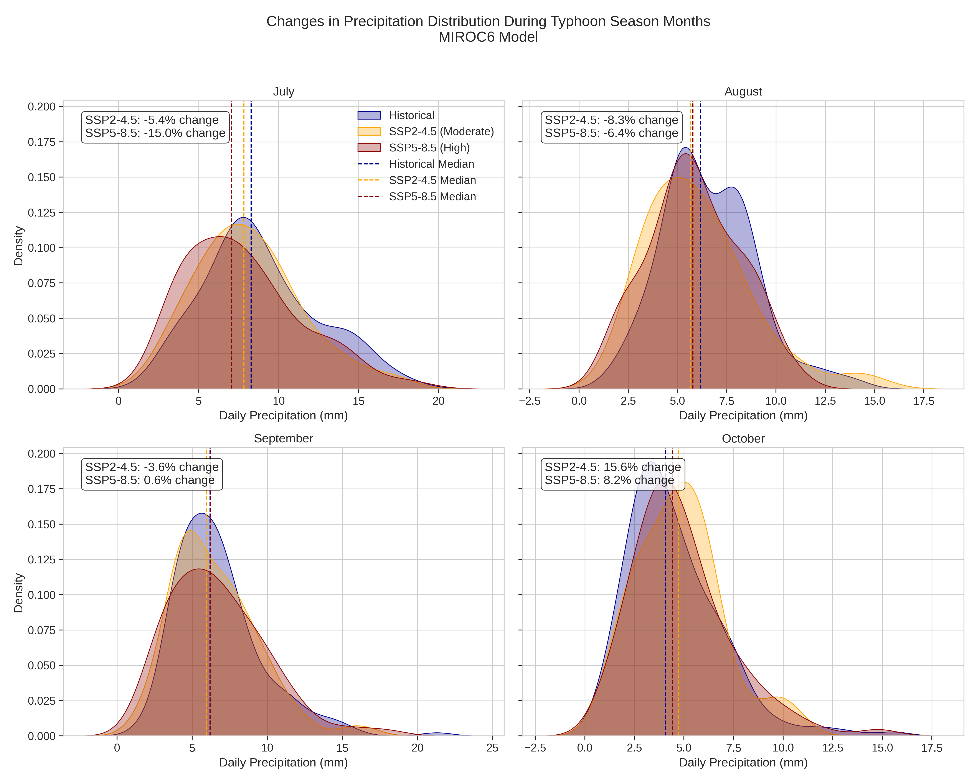
🌪️ Tokyo – Typhoon Season Risk 🌪️
July & August: Both scenarios show reduced daily rainfall, with SSP5-8.5 showing larger decreases
September: Minimal change; SSP5-8.5 shows a slight increase
October: Clear increase in rainfall under both scenarios — strongest signal under SSP2-4.

Slide 21
Conclusions and Key Findings
Air Temperature: Projected to rise significantly over the next century, increasing risks of droughts, heatwaves, and wildfires.
Precipitation: Trends are more complex — a mixture of slight negative, positive or stable trends overall, but with a clear increase in extreme events and seasonal shifts in rainfall patterns.
🌍 Key Findings By Location
London
Flood risk remains stable during mid-century
Increased flood risk from heavier rainfall towards end of the century under both scenarios
Los Angeles
SPI shows possible increase in precipitations extremes
Extreme temperatures that were historically rare become common – particularly under SSP585
Tokyo
Typhoon-season rainfall shifts to later months
October extremes increase; daily peak may slightly decline

Slide 22
Final Reflections & Recommendations
Climate extremes are projected to intensify — frequency, severity, and duration will all increase
Current analysis is limited to temperature and precipitation, monthly data, and two scenarios
Future work should use daily datasets, a multi-model approach, and integrate variables like humidity and wind for compound risk assessment
What future are we planning for — and how fast must we act?

Slide 23
Thank you
Questions?
Spencer Read
spencerread@hotmail.co.uk
All code for project available on GitHub:
https://github.com/spencereread/CMIP6-Project

Slide 24
References
Carvalho, D., Cardoso Pereira, S. & Rocha, A. Future surface temperatures over Europe according to CMIP6 climate projections: an analysis with original and bias-corrected data. Climatic Change 167, 10 (2021). https://doi.org/10.1007/s10584-021-03159-0

